Slide 1
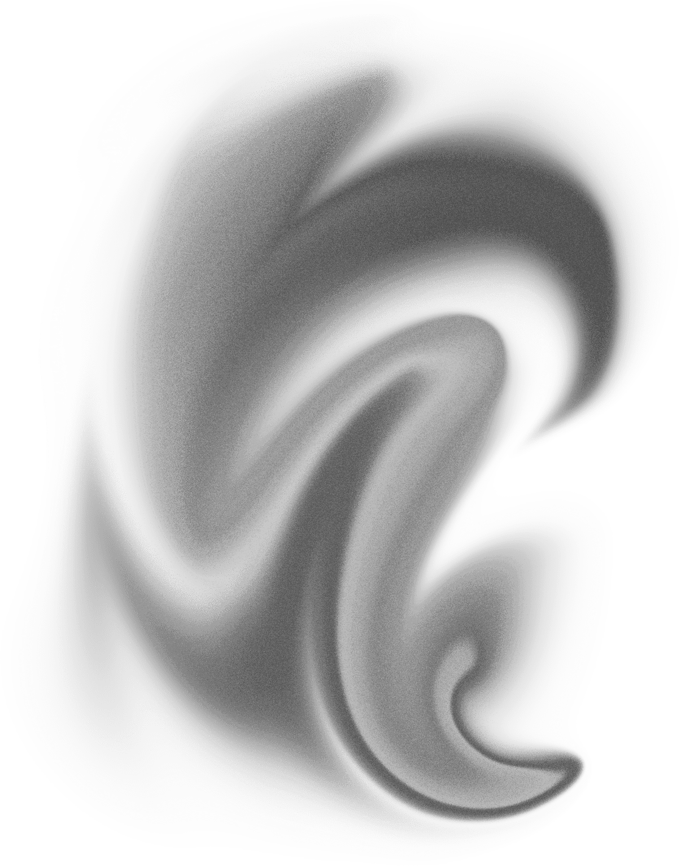
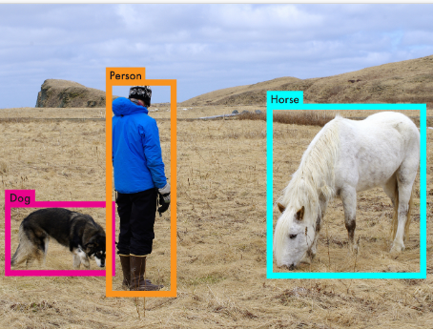

YOLO v1
Most accurate and fastest object detector in 2016

Slide 2
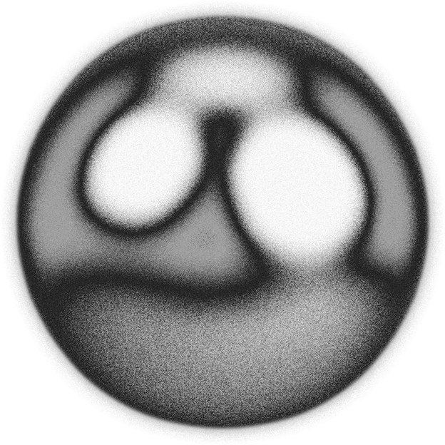
Agenda
Topics Covered
Introduction to YOLOv1
Algorithm
Architecture
Loss Function
Implementation

Slide 3
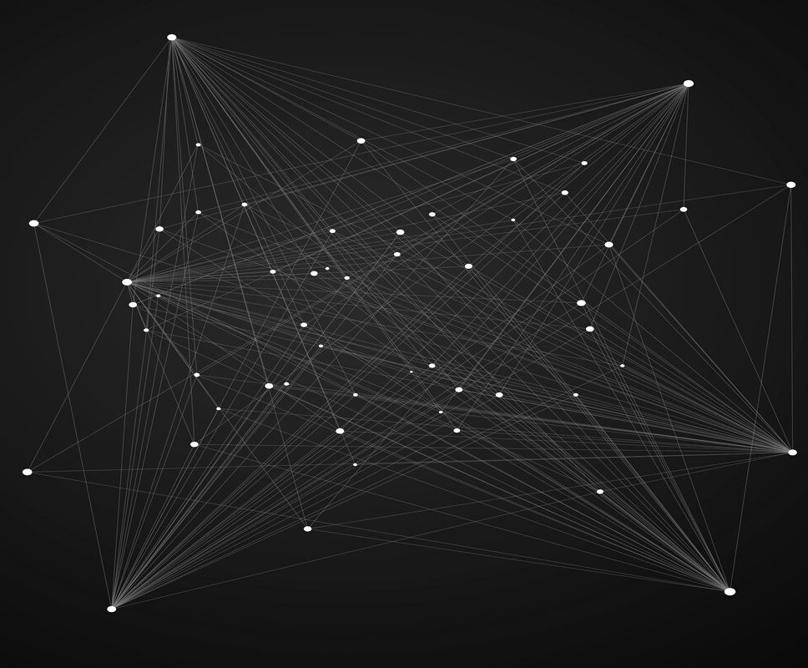
Introdution
You Only Look Once broke onto the computer vision scene in 2015 via a paper written by Joseph Redmon, Santosh Divvala, Ross Girshick, and Ali Farhadi.
Object detection evolved from the traditional methods to the deep learning methods, moving from Viola-Jones detectors, HOG detectors, and Deformable Part-Based Models to convolutional neural networks and deep convolutional networks.

Slide 4
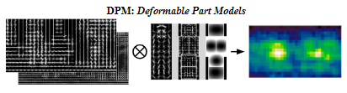
Evolution of Object Detectors
Viola Jones detector
It was the first one who did facial recognition and gave extremely good results. It used a sliding window and searched across the image to find a bounding box in which the face is enclosed.
Histogram of Oriented Gradients (HOG)
In 2005, HOG detector came which used gradients and was scale-invariant.
CNNs
Around 2012 was the time when deep learning had won the Imagenet challenge and the world saw the rebirth of convolutional neural networks.

Slide 5
After 2014, Object detection takes a two-faced approach
One-stage detection
Two-stage detection
Include RetinaNet, YOLO, and Single Shot Multibox Detector.
Cascade R-CNN, Fast R-CNN, and Mask R-CNN

Slide 6
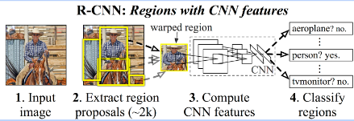
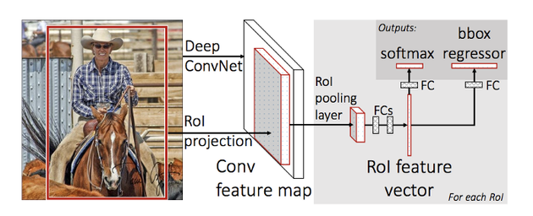
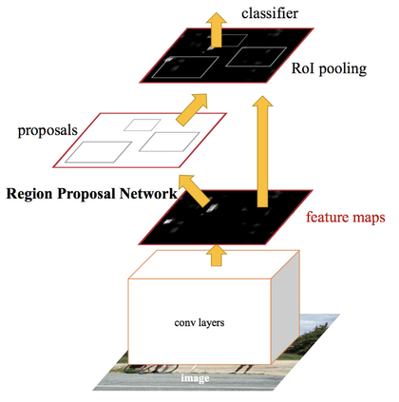
Two stage
detectors
RCNN (2014)
R-CNN initially uses selective search to find a manageable number of bounding-box object region candidates(ROI) and then it extracts CNN features from each region for classification.
Fast RCNN (2015)
It is an improved version of the initial R-CNN, where most of the upgrades concern speed. Advantages include higher detection quality, as compared to R-CNN
Faster RCNN
It is one of the most robust version of the R-CNN family. The Faster R-CNN method takes the selective search algorithm adopted by R-CNN and Fast R-CNN to the next level by using the superior region proposal network.

Slide 7
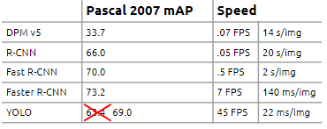
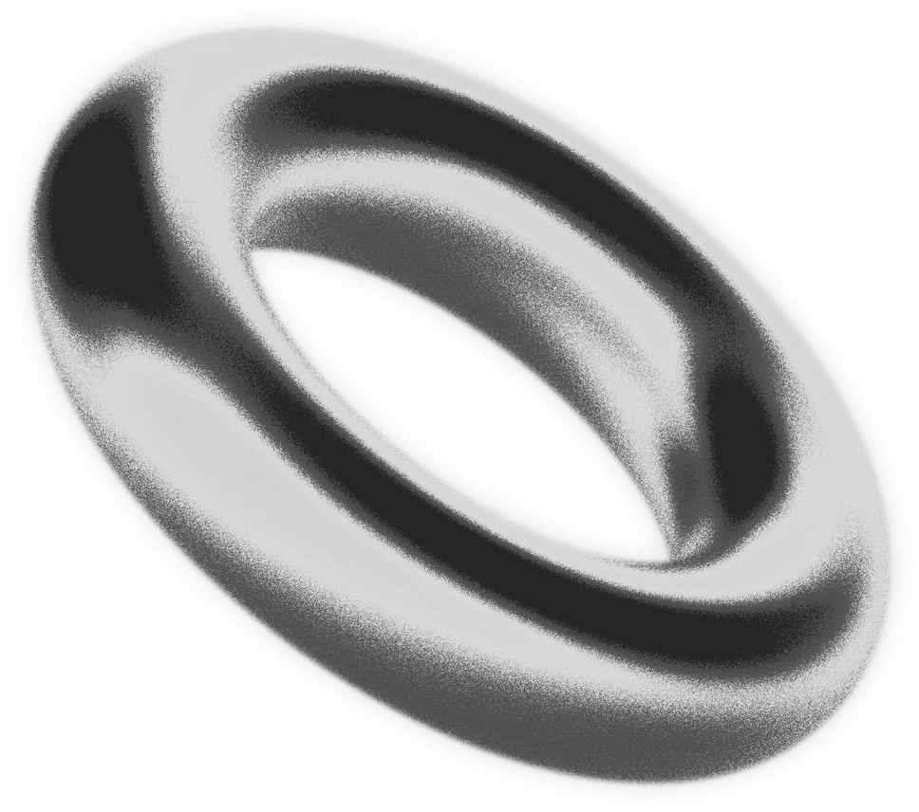
Accurate object detection is slow!

Slide 8
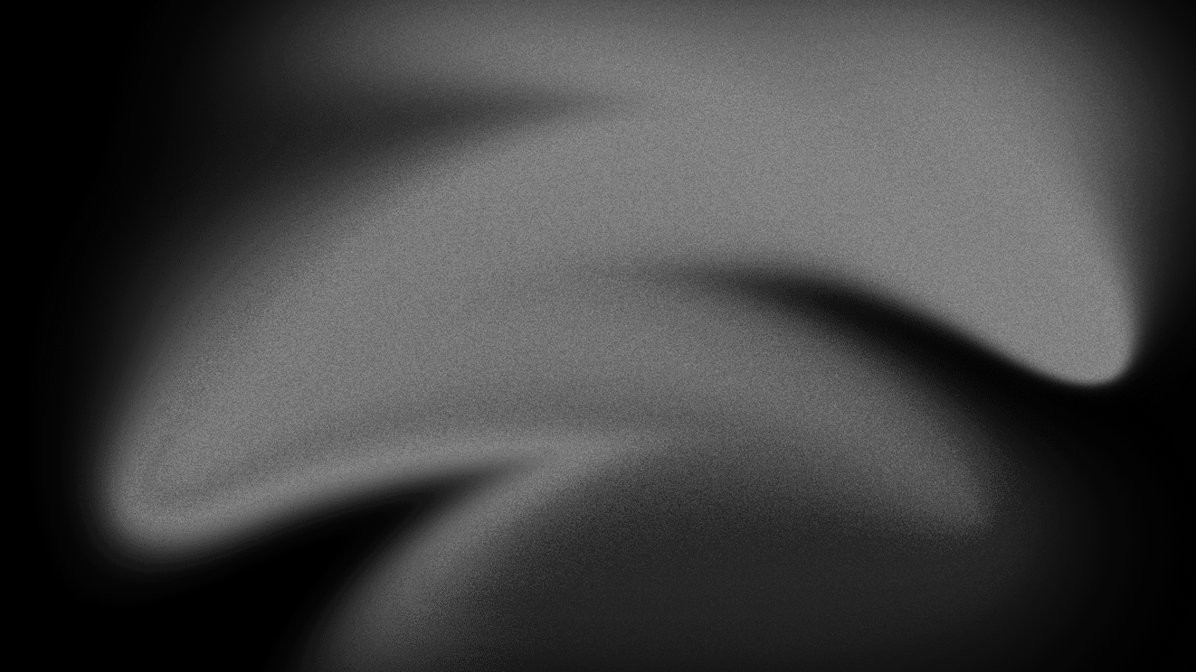
YOLOv1
The Algorithm

Slide 9
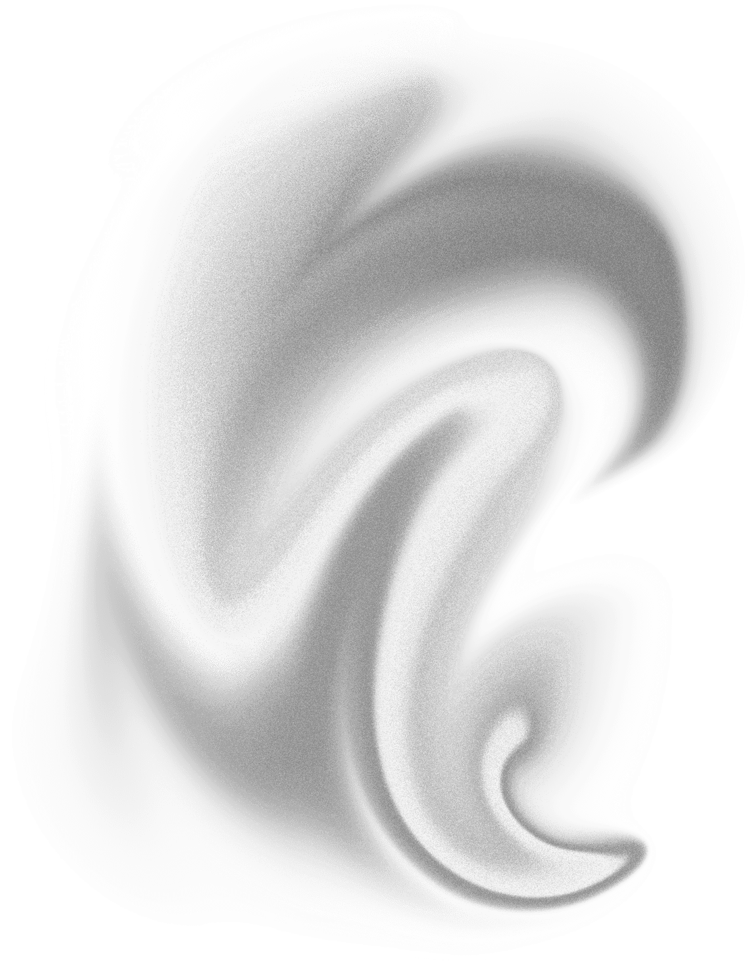
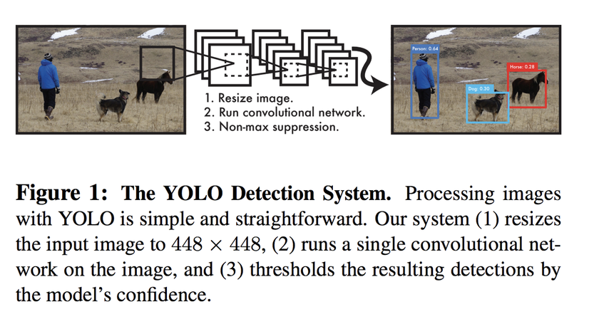
YOLOV1
YOLO combines what was once a multi-step process, using a single neural network to perform both classification and prediction of bounding boxes for detected objects.
It looks at the entire image at once, and only once — hence the name You Only Look Once — which allows it to capture the context of detected objects.

Slide 10
Why YOLOV1?
Very Fast
Less Errors
Generalizes well
Less False Positives
YOLOV1 is an extremely fast object detection technique that processes images in real-time at 45 frames per second.
YOLO makes less than half the number of background errors compared to Fast R-CNN.
Additionally, YOLO can generalize the representations of various objects, making it more applicable to a variety of new environments.
This halves the number of false-positive detections it makes over R-CNNs which look at different parts of the image separately.

Slide 11
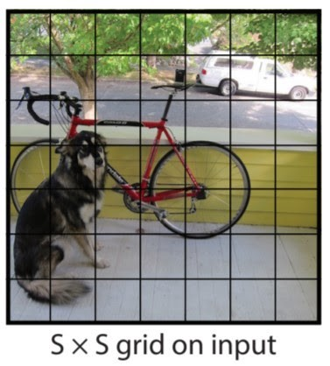
Algorithm
The input image is divided into an S×S grid (S=7).

Slide 12
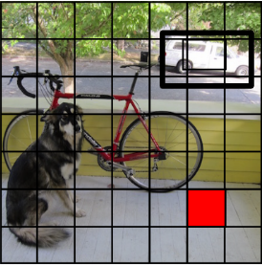
Bounding Boxes
Each grid cell predicts B bounding boxes (B=2) and confidence scores for those boxes.
These confidence scores reflect how confident the model is that the box contains an object, i.e. any objects in the box, P(Objects).

Slide 13
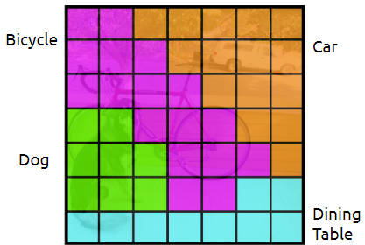
Class Probability
Each grid cell also predicts conditional class probabilities, P(Classi | Object). (Total number of classes=20)

Slide 14
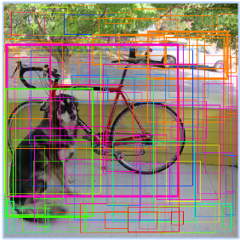
Class Probabilities
Then we combine the box and class predictions.

Slide 15
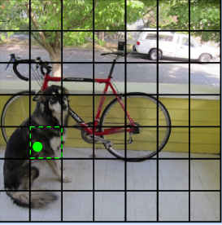
Center Coordinate
The cell in which the center of an object, for instance, the center of the dog, resides, is the cell responsible for detecting that object.

Slide 16
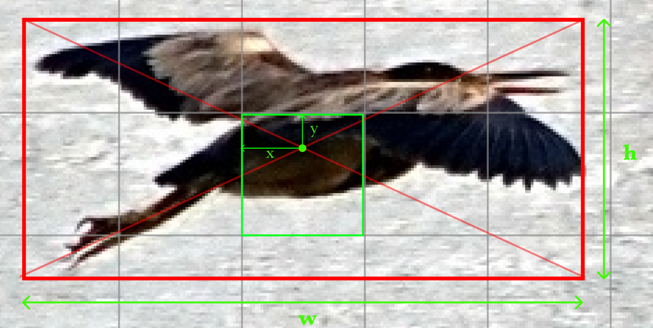
Center Coordinate
A bounding box prediction consists of 5 elements: The x,y,w,h values of the bounding box and P(Object), the probability that there is an object whose center falls within this grid cell

Slide 17
Center Coordinate
The x, y coordinates of the bounding box are predicted relative to the grid cell and not the entire image but the width and height (w,h) are predicted relative to the entire image.

Slide 18
Center Coordinate
For use later in loss calculations, the ground truth bounding box cordinates are all parameterised to be between 0 and 1.
The width and height of the bounding box are calculated as a ratio of the entire image's width and height.
The (x,y) grid cell offsets are parameterized as a ratio of a grid's width and height.

Slide 19
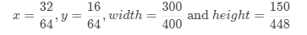
Center Coordinate
For example, given the a 448 X 448 image and S = 7.
By dividing the width or height of the image by S, we have a grid dimension where each grid cell is 64×64 pixels wide.
Therefore a bounding box from our dataset with x = 32, y = 16, width=300 and height = 150, would be parameterised as

Slide 20
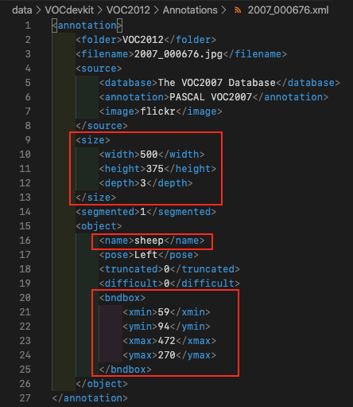
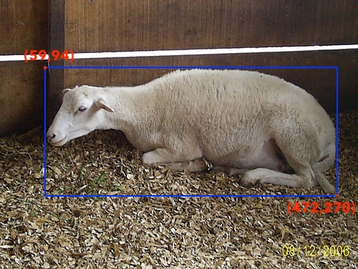
Center Coordinate
The Pascal VOC Dataset uses (x1,y1,x2,y2) instead of (x,y,w,h).
A sample image with its corresponding annotation file is shown below, the parts of the annotation file to observe have been highlighted in red.

Slide 21
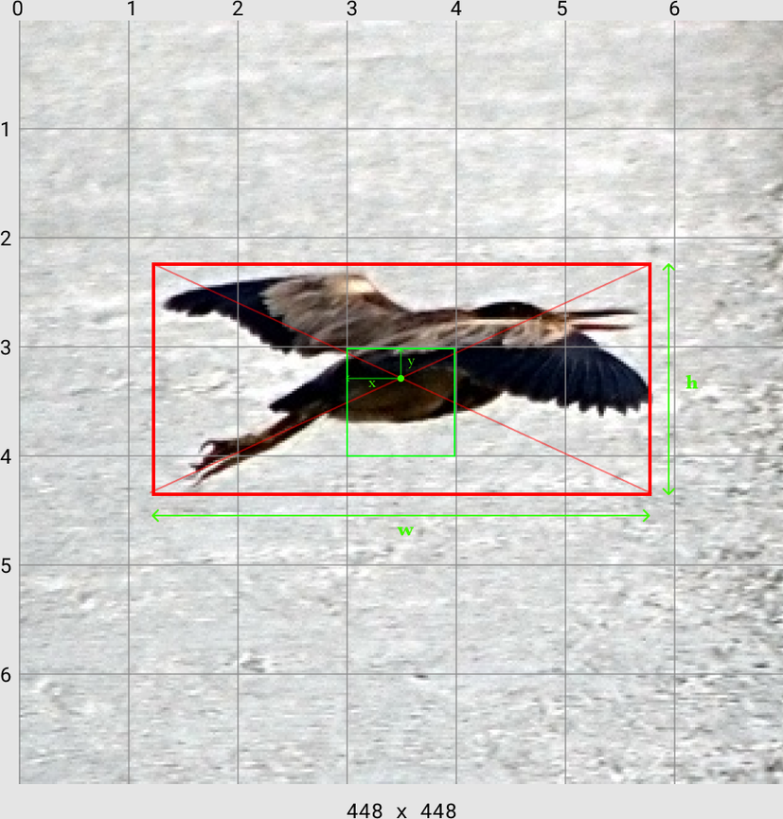
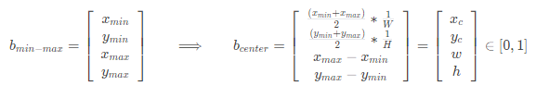
Center Coordinate
In this case we need to convert the min max encoding to center encoding first.
Let the bounding box coordinates in min-max encoding be defined as bmin−max​ and the bounding box coordinates in center encoding be defined bcenter​.
Where W, H are the width and height of the image respectively, Converting from b min−max to b center can simply be defined as

Slide 22
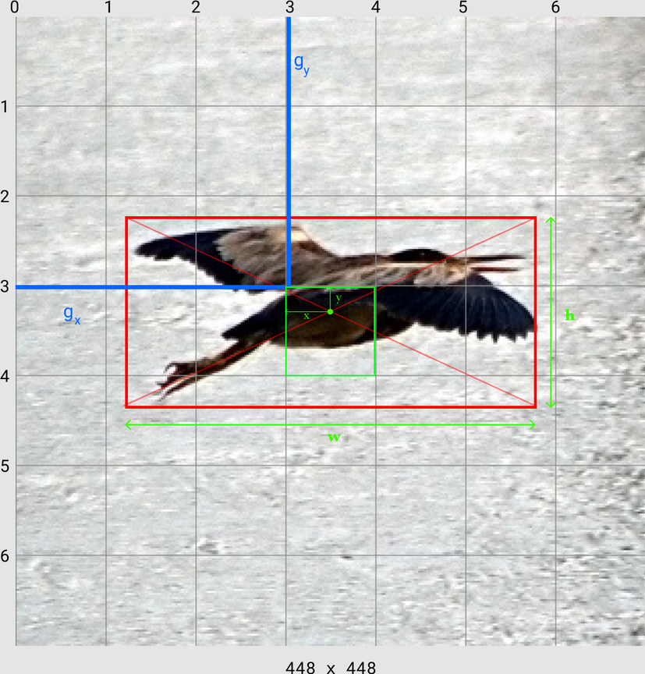
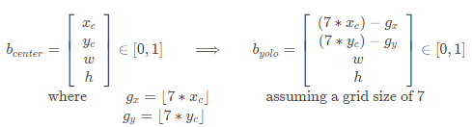
Center Coordinate
We currently have bcenter​ which contains the x,y location of the object center and the width and height of the object, scaled between 0 and 1.
To convert this to YOLO bounding box encoding (byolo​) which takes the x,y location of the object center (relative to the image's width and height) and converts it to an (x,y) coordinate relative to the grid cell
The width and height are left as they are in the YOLO encoding.

Slide 23
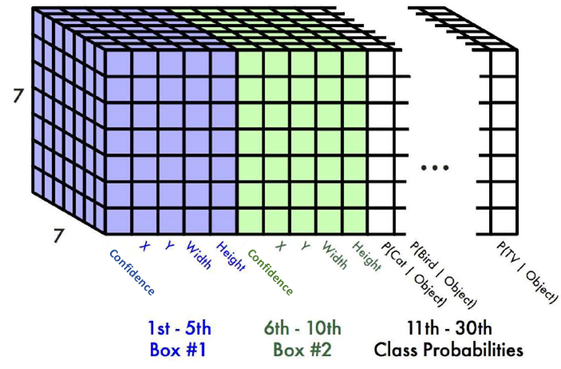
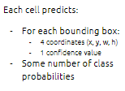
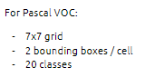
Output
Ground Truth = (c, x, y , w, h, P(cat|object)............P(TV|object))
=7 x 7 x 25 Ground truths
Prediction = (c1, x1, y1 , w1, h1, c2, x2, y2 , w2, h2, P(cat|object)............P(TV|object))
7 x 7 x (2 x 5 + 20) = 7 x 7 x 30 tensor = 1470 Predictions

Slide 24
YOLOv1
Architecture

Slide 25
Architecture
The initial convolutional layers of the network extract feature from the image while the fully connected layers predict the output probabilities and coordinates.
It has 24 convolutional layers followed by 2 fully connected layers.
Alternating 1×1 convolutional layers reduce the features space from preceding layers. (1×1 conv has been used used in GoogLeNet for reducing number of parameters.)

Slide 26
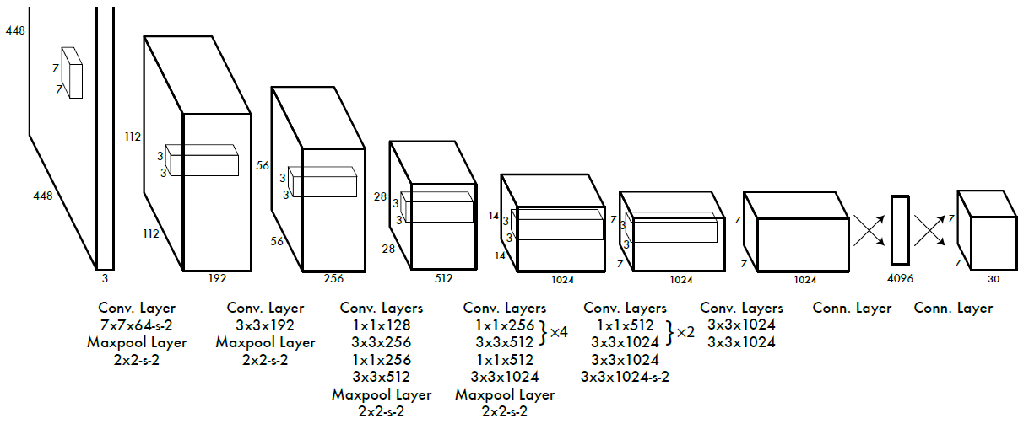
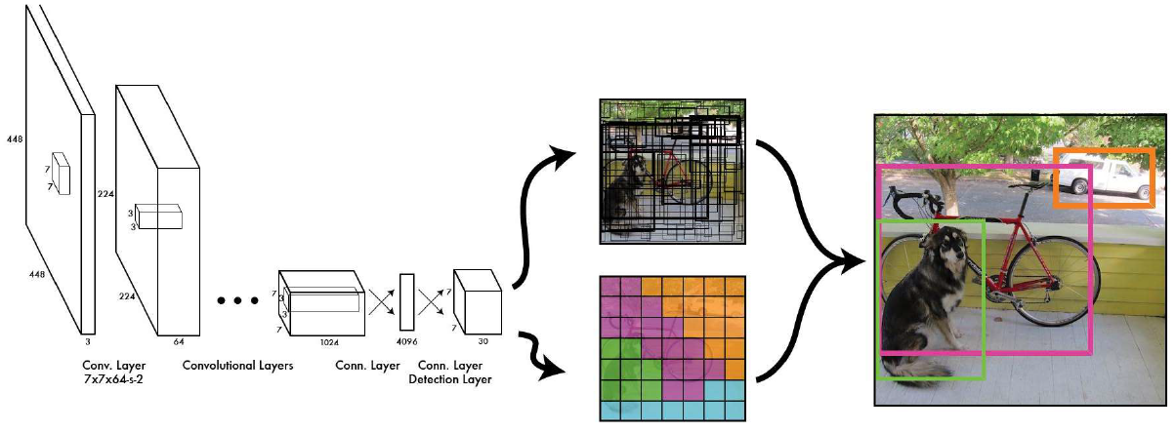

Slide 27
YOLOv1
Loss Function

Slide 28
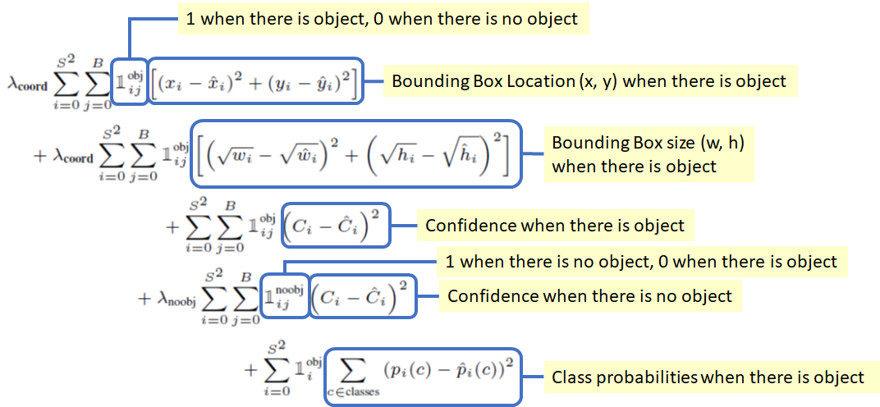
Loss function

Slide 29
Loss function
There are 5 terms in the loss function as shown below.
1st term (x, y): The bounding box x and y coordinates is parametrized to be offsets of a particular grid cell location so they are also bounded between 0 and 1. And the sum of square error (SSE) is estimated only when there is object.
2nd term (w, h): The bounding box width and height are normalized by the image width and height so that they fall between 0 and 1. SSE is estimated only when there is object. Since small deviations in large boxes matter less than in small boxes, square root of the bounding box width w and height h instead of the width and height directly to partially address this problem.

Slide 30
Loss function
3rd term and 4th term (The confidence) (i.e. the IOU between the predicted box and any ground truth box):
In every image many grid cells do not contain any object.
This pushes the “confidence” scores of those cells towards zero, often overpowering the gradient from cells that do contain objects, and makes the model unstable. Thus, the loss from confidence predictions for boxes that don’t contain objects, is decreased, i.e. λnoobj=0.5.

Slide 31
Loss function
5th term (Class Probabilities): SSE of class probabilities when there is objects.
λcoord: Due to the same reason mentioned in 3rd and 4th terms, λcoord = 5 to increase the loss from bounding box coordinate predictions.

